Slide 1
Welcome new GSRs! Basics – Part 1: Getting Started
District 21
January 27, 2026

Slide 2
WELCOME to General Service!
Brief overview of General Service Structure
Where to look/go to for more information
Agenda Topics

Slide 3
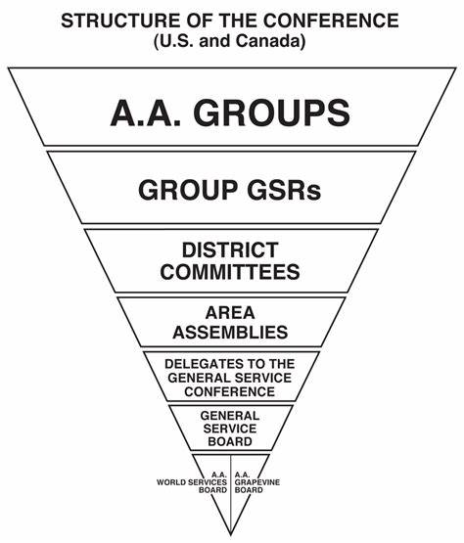
AA’s 3 Legacies:
Unity
Recovery
Service

Slide 4
Tips for starting on your Service journey:
Celebrate! General Service is a great way to contribute to our Primary Purpose and deepen our commitment to our sobriety
Fill out the GSR Change Form – “fillable” form on Area 07 website: cnia.org
  This triggers GSO to send you a GSR “Kit” and Service Manual
Use the aaplacer.org website
Read the GSR Handbook
Participate in the monthly Service Study on Zoom
  Second Monday from 6:00-7:00pm
  Meeting ID 223 661 3304 PW: District21

Slide 5
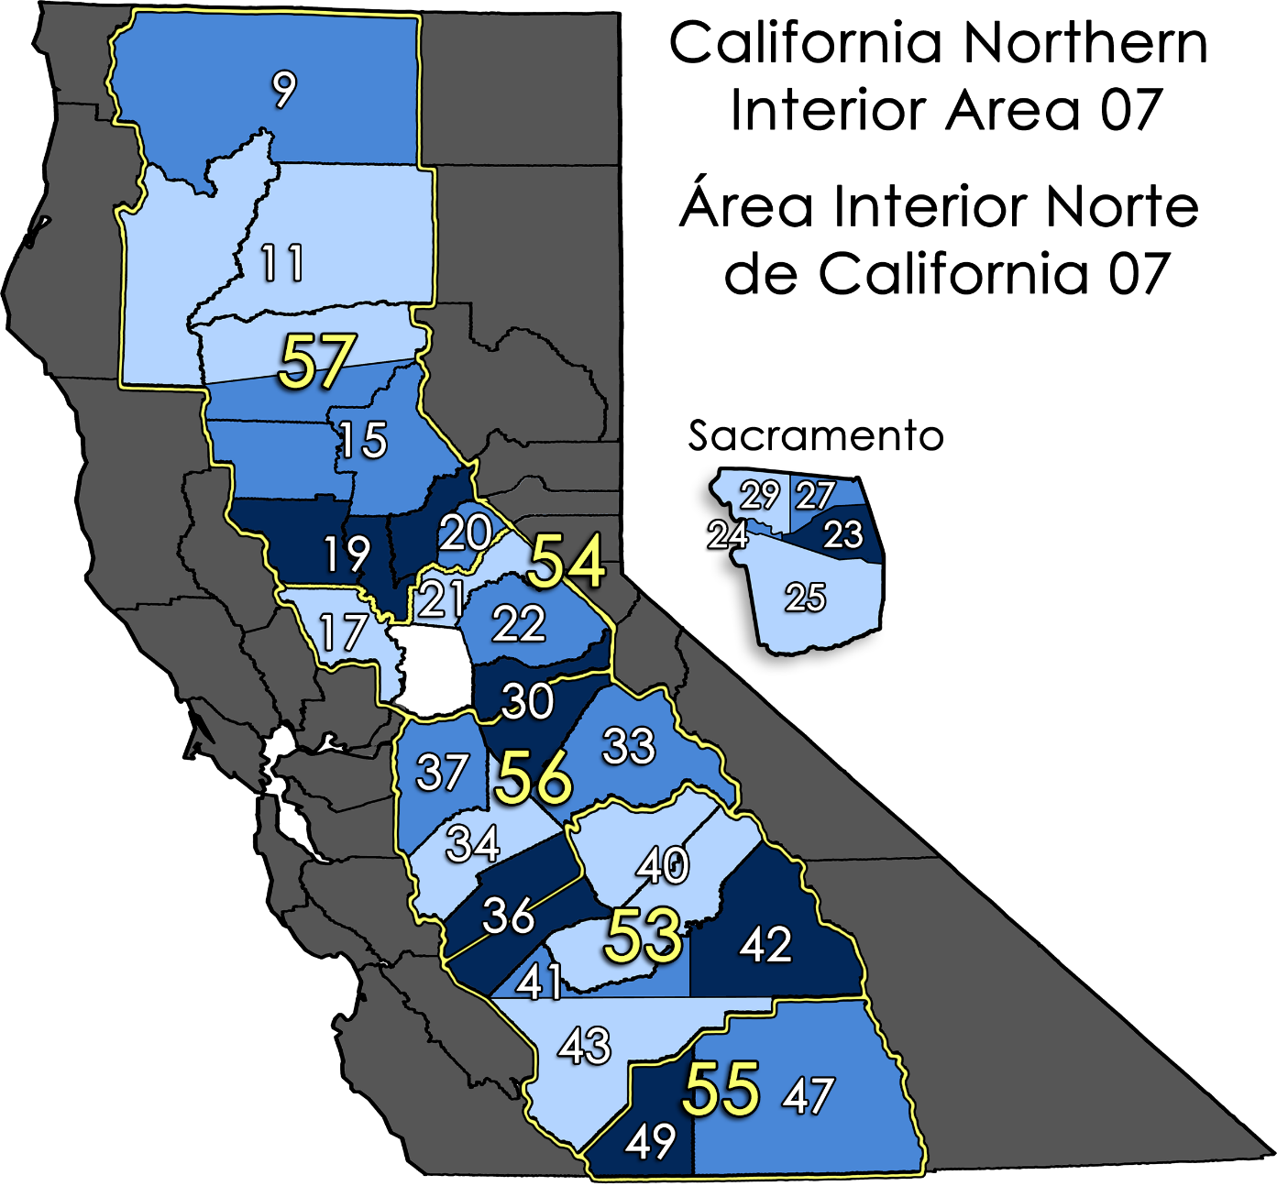
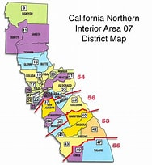

Slide 6
GSR – Trusted Servant Tasks and Tips
Your Role as a GSR
  YOU are the VOICE of your Group! You are a voting member of District 21 at District meetings, and of Area 07 at Area Assemblies
  Assist your Group in interpreting the Traditions for group issues (ex: substantial unanimity, minority opinion)
Your Responsibility as a GSR
  Participate in the monthly District 21 meeting – 4th Tuesday at 6pm, Auburn Fellowship, 534 Auburn Ravine Rd., Auburn
  Participate in your group’s business meetings
  Participate in four annual Area 07 Assemblies and other events as your Group allows
  Ensure your Group’s voice is heard and is informed about issues affecting “AA as a whole” through the annual General Service Conference Agenda Topics input and feedback process.

Slide 7
Meetings, Assemblies and Options:
District 21 meeting: 4th Tuesday at 6:00pm at Auburn Fellowship, in person at 534 Auburn Ravine Rd., Auburn, and on Zoom at 223 660 3304 / passcode District 21
Service Study: 2nd Monday at 6:00pm on Zoom 223 661 3304 / passcode District 21
2026 Area 07 Assemblies:
  Winter Assembly January 17-18 in Orangevale
  Pre-Conference Assembly April 18-19 in Yuba City
  Post-Conference Assembly May 16-17 in Merced
  Fall/Election Assembly November 13-14 in Woodland
  OPTIONAL:
  Area 07 Committee Meeting – 3rd Saturday of every month (except Assembly months)
  PRAASA (Pacific Region AA Service Assembly) – February 27-March 1 in Honolulu

Slide 8
2026 GSR Budget - Estimates
Date | Assembly | Location | Registration | Coffee & Dinner | Mileage | Hotel | Notes | Cost per event
January | Winter Assembly | Folsom/D27 | $24.00 | $ 25.00 | $ 19.00 | $ - | No overnight needed | $ 68.00
April | Pre-Conference Assembly | Yuba City/D19 | $24.00 | $ 25.00 | $ 59.00 | $ - | No overnight needed | $ 108.00
May | Post-Conference Assembly | Merced/D53 | $24.00 | $ 25.00 | $ 184.00 | $ 70.00 | Lodging- 1 night | $ 233.00
November | "Mini-PRAASA" Assembly | Woodland/D17 | $24.00 | $ 25.00 | $ 143.00 | $ - | No overnight BUT drive 3 days | $ 242.00
Annual Total |  |  |  |  |  | (3b) |  | $ 651.00
(1a) Registration/Dinner & Coffee - Est $24 for Reg., $20 for dinner + $5 for bottomless coffee (NOTE: District only reimburses registration)
(2a) Round Trip Mileage - will vary - estimate is from Roseville to the City Assembly location. Est IRS mileage reimbursement at $.72/mi.
(3a) Hotel room rate est 1/2 cost for out of town assemblies. Most share rooms to split cost with other group GSR(s) or "back to basics" housing
(4a) Cost per event - Total anticipated cost per event on each line (NOTE: LESS COST IF SHARING hotel and driving when possible)
(4b) Total anticipated cost for group to fund GSR to all four (4) assemblies for the year
Summary: | Yearly Total (4b) divided by 52 weeks (year) = total cost per week for group to support GSR for the year
example: (4b=$546) $546/52=$10.50 |  |  |  | $ 10.50 | per week for group to support GSR to assemblies
Note:
GSR Support is typically budgeted as a group basic expense (like meeting space, coffee, etc.) before any disbursements to Area, GSO, District, CCFAA, etc.
GSR participation in Area Assemblies ensures the Group has a vote/voice and supports our Area and GSO
GSR is accountable to the group with the group's support
Service positions should not be contingent on an individual member's ability/inabliity to pay
Our group should be self-supporting without having to rely on the district for scholarships if at all possible
Appeal to District for scholarship or partial scholarship IF your group is not able to fund/fully fund GSR to attend Assemblies.
This does not include additional assemblies, such as PRAASA or Regional Forums
GSR Expenses

Slide 9
More Information:
AA Service Manual – 2024-26 Edition
CNIA 07 “GSR School”
GSR Packet – materials and pamphlets
Service Sponsor
District 21 Officers and GSRs
Monthly D21 Service Study - Zoom Meeting (2nd Monday at 6:00pm)*TBD

